Slide 1
Embedded “Doodle Jump” Game on the Micro:bit v2
Author: Haolan Zhan

Slide 2

Doodle Jump

Slide 3
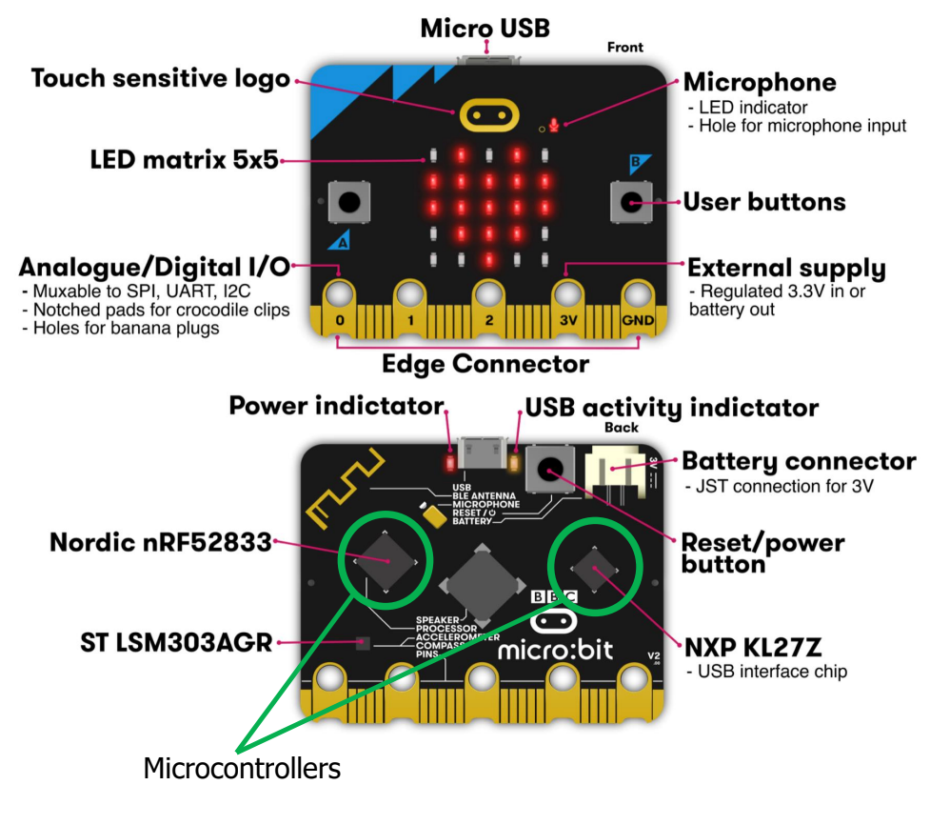
Micro:bit V2

Slide 4
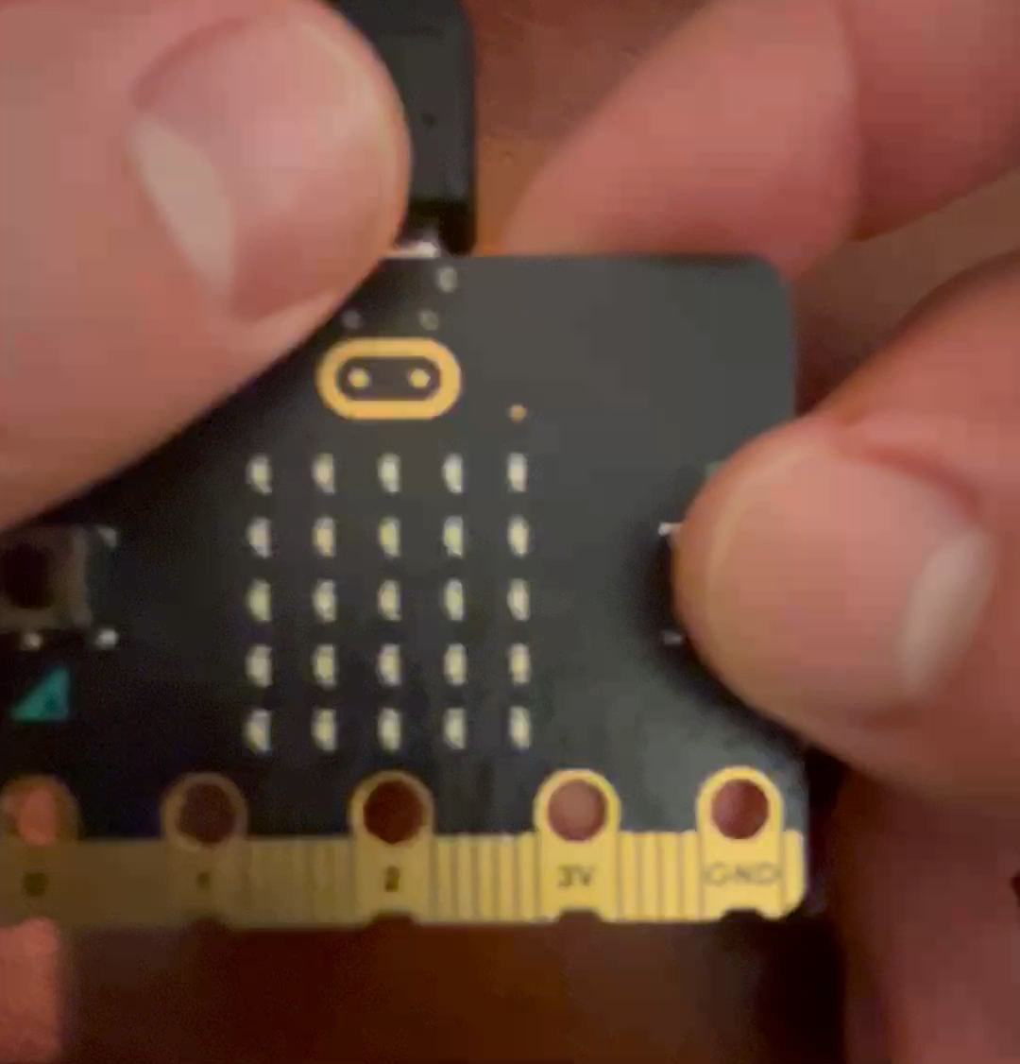

Slide 5
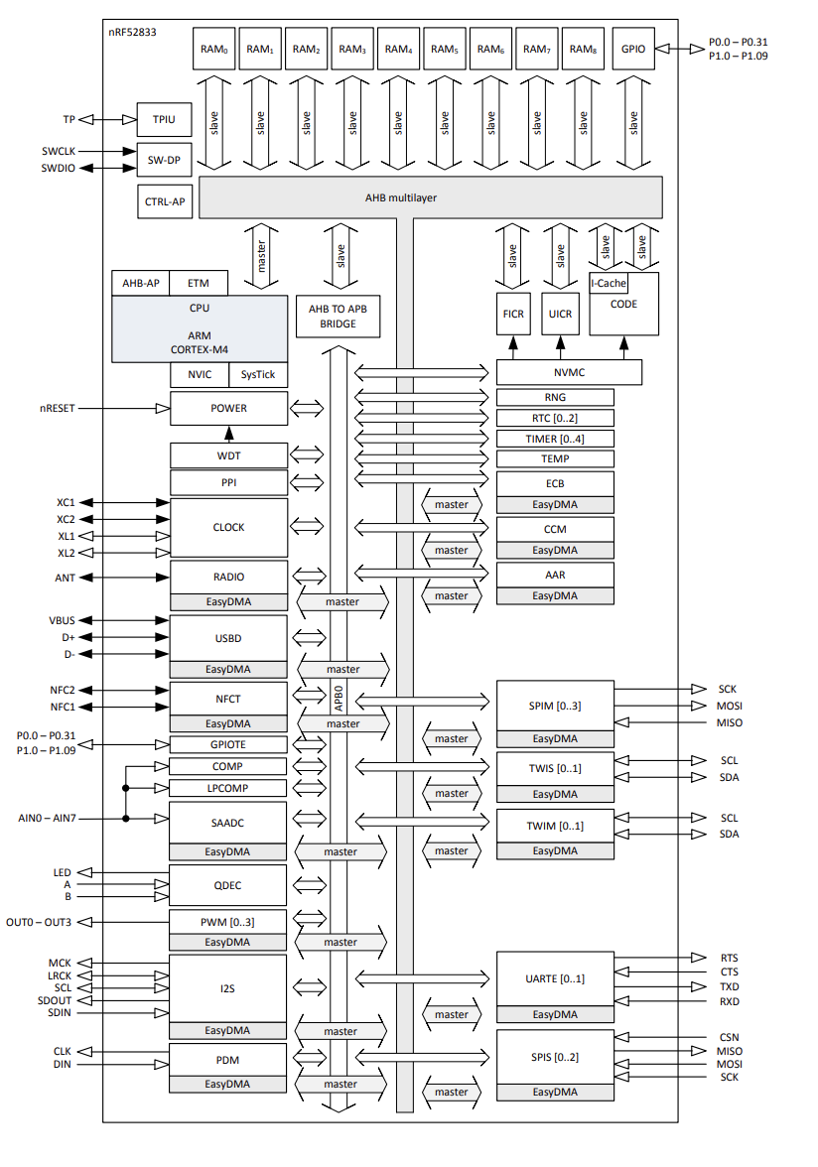
Hardware components: nRF52833
Nordic Semiconductor nRF52833
ARM ® Cortex ® -M4 32-bit processor with FPU, 64 MHz
1.7 V to 5.5 V supply voltage range
512 kB flash and 128 kB RAM
Memory Mapped Peripherals:
42 general purpose I/O pins
Up to 2x I2C compatible two-wire interface
Timer/Counter
RNG

Slide 6
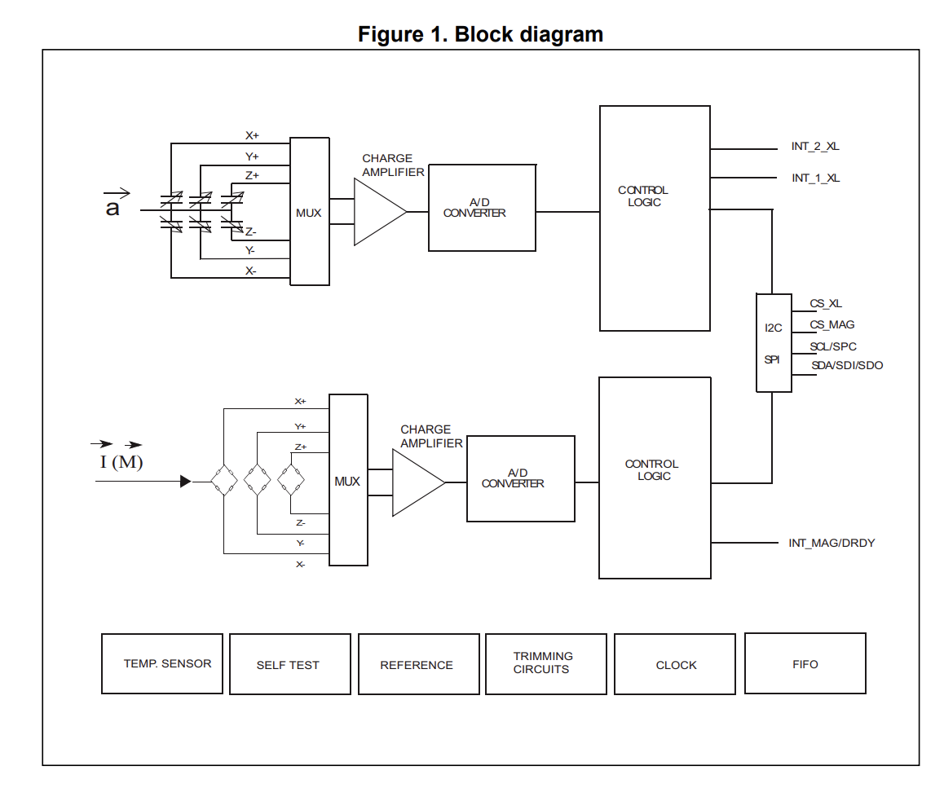
Hardware Components: Lsm303agr
STMicroelectronics LSM303AGR
Ultralow-power 3-axis Accelerometer and Magnetometer
I2C Interface
±2/±4/±8/±16 g selectable acceleration range
±50 gauss magnetic dynamic range

Slide 7
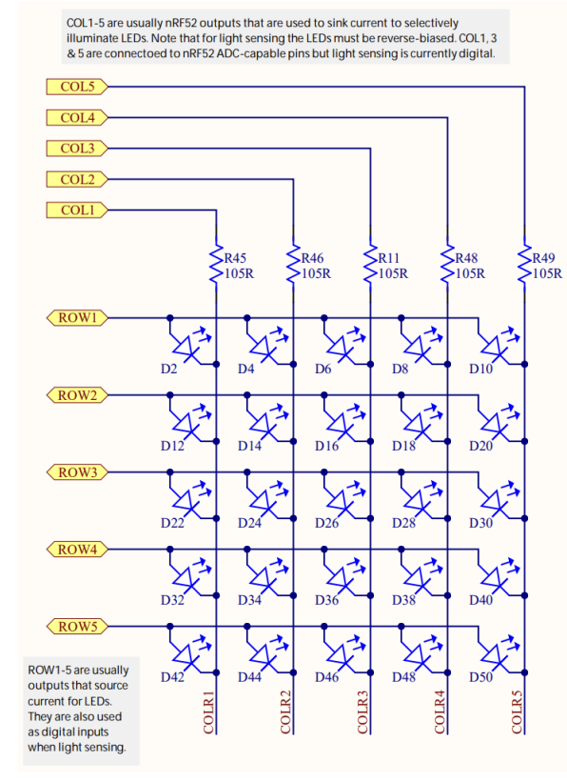
Hardware Component: Micro:bit Peripherals
Active high 5x5 LED matrix
Row and Column pins mapped to GPIO
Set row to 1 and Column to 0 to turn on
Cannot independently control each LED, must display one row at a time and cycle through each row repeatedly
Active Low A and B buttons
Mapped to GPIO

Slide 8
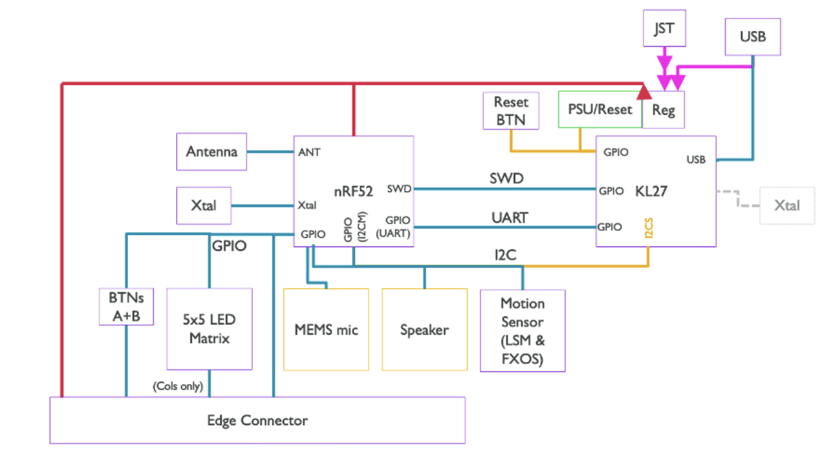
Hardware Block Diagram

Slide 9
Software Block Diagram
Button 1 Press
(reset)
Initialization State
Upon completion of initialization
Game Start State
Button 1 Press
(reset)
Button A or B Press
Game Play Loop
Character Falls off the Edge of the Screen
Game Over State

Slide 10
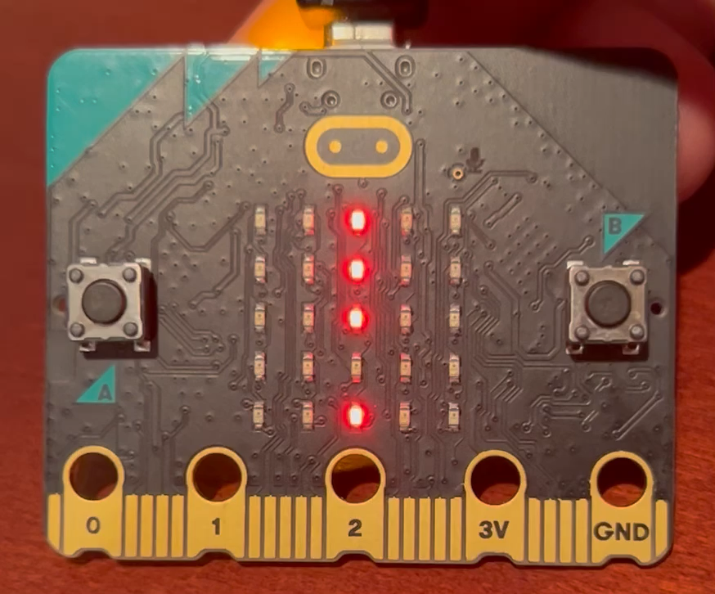
Overall Main Architecture (main.c)
Initialization:
Init MCU and peripherals (GPIO, LED Matrix, Timers, I2C, RNG)
Init Lsm303agr device
Init game elements
Game Start State:
Display the following string on the LED Matrix: “Play Doodle Jump! Press a button to start”
Game Play Loop:
Upon firing of Platform timer: control platform movement/location
Upon firing of Character timer: control character movement/location
Display game play on the LED Matrix
Keep Track of Score (how many platforms fall below the screen)
Game Over State:
Clear the screen
Print score to terminal if connected to debugging interface

Slide 11

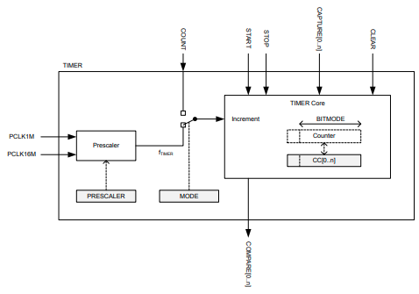
Timer Interface
Physical peripheral:
Set prescaler to control timer frequency
Set CAPTURE to copy the counter value to CC
Set CC to a value, and the EVENT will generate an event on counter == CC
Can enable interrupts on EVENT
Virtual Implementation:
Linked List, with sorted insert based on timer expiration time
Set expiration time to current CC count + desired ticks, and insert node
CC is set to the expiration time of the list head
Upon event generation, interrupt triggers callback function, and the list head is removed (or added with an updated expiration time)

Slide 12
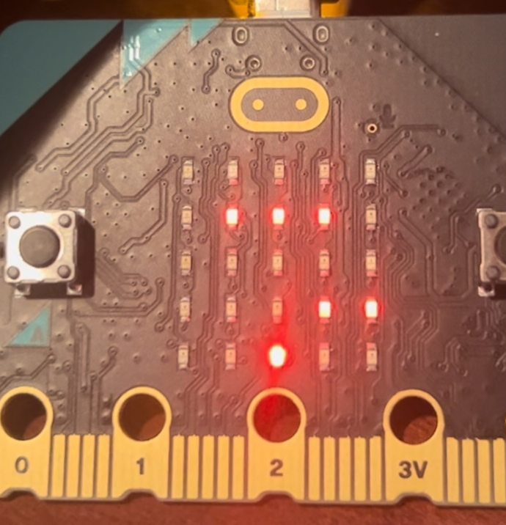
Platform unit (platform.h/platform.c)
Platform struct fields: active, row, length, col_start
Array of 3 platforms
Random length (between 2 and 3), and random col_start
Init as inactive, and at top row
Activate Platform Timer Callback
Periodically activate first inactive row in the array
Next Row Timer Callback
For each active platform move one row down
If platform is at the bottom row, deactivate the platform, re-randomize the length and col_start, reset row to top, and increment the game score

Slide 13
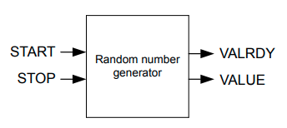
RNG Driver
Set Config register for bias correction and disable interrupts on data ready
Start Random Number Generation
Read Value register
Bit mask to get desired range of random values
Stop Random Number Generation

Slide 14
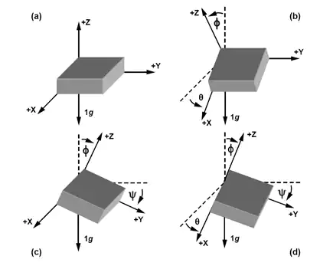
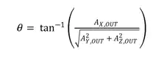
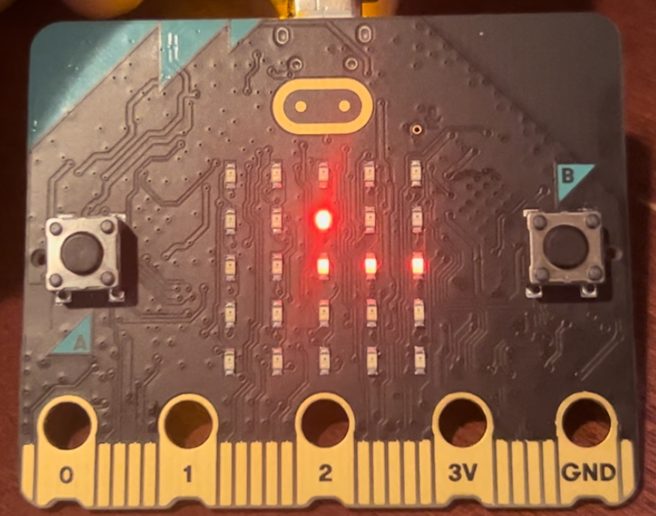
Character Unit (char.h/char.c)
Char struct fields: active, row, col, jumps
X Motion Timer Callback
Read 3-Axis Acceleration from the Lsm303agr and calculate the tilt angle
If tilt angle > 20 degrees, move character one column right
If tilt angle < -20 degrees, move character one column left
Supports looping around both sides of the LED Matrix
Y Motion Timer Callback
If jumps is 0, character is falling, move down one row
Edge case: bottom row
If jumps is nonzero, character is in the middle of a “jump”
Move up one row, and decrement jumps
Edge case: top row

Slide 15
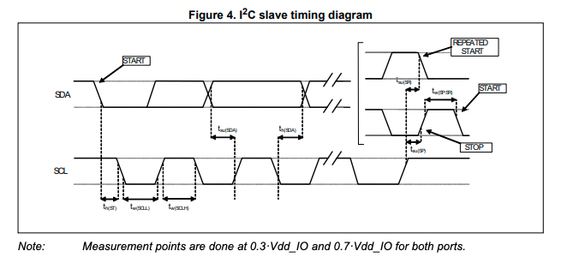
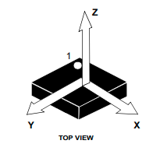
LSM303AGR driver
I2C communication with accelerometer
Helper functions for one byte read (write-read repeated start) and one byte write
Init Accelerometer for 100Hz, normal mode (10-bit), and enable all 3 axis
Read/concatenate ACC_OUT_HI, ACC_OUT_LOW and shift right by 6 bits for each Axis
Multiply by the sensitivity and return results in a measurement struct

Slide 16
LED Matrix Unit (led_matrix.h/led_matrix.c)
General LED Display Timer Callback:
Turn off all rows, clear the columns needed to display a single row, and turn on that row
On the next callback, repeat for the next row
Game Start State:
Use the above algorithm to display one ASCII character at a time
A timer callback that increments the character index to display the next one in the string
A timer callback that checks if either of the two buttons have been pressed
Game Play State:
Keep track of a 5x5x4 LED States array – row, col, duty cycle
Populate the array with the location of all active platforms
Detect collision between character’s current location and any platform
Add the character location to the array
Use the above algorithm to display the game, with added PWM complication to mimic brightness
Cycle through all duty cycles for a single row on each callback before moving on to the next row

Slide 17

Possible Improvements
Code organization:
Initialization behavior spread across many functions and is not as organized as it should be
Use hardware interrupt for button to start the game, instead of a timer
Redundancies in led_matrix.c functions for game display and displaying a string
Display final score on the LED Matrix
Loop initial message so that it plays back repeatedly
Priority Queue data structure for Virtual Timers
Consider changing architecture to rely on main loop instead of repeated timers

Slide 18

Thank You!!!

Slide 19
Sources
https://infocenter.nordicsemi.com/pdf/nRF52833_PS_v1.5.pdf
https://www.okdo.com/wp-content/uploads/2020/10/BBC-microbit-v2-datasheet-v1.2.pdf
https://www.st.com/en/mems-and-sensors/lsm303agr.html
https://www.digikey.com/en/articles/using-an-accelerometer-for-inclination-sensing
https://github.com/haolanzhan/Embedded-Game-Developed-on-Microbit/blob/main/software/apps/virtual_timers/virtual_timer.c

